Slide 1
AFRICAN AMERICAN READ- IN
“The African American Read-In (AARI) . . . is built on an ambitious yet confident premise: that a school and community reading event can be an effective way to promote diversity in children’s literature, encourage young people to read, and shine a spotlight on African American authors.”
NCTE Council Chronicle, November 2014 (National Council of Teachers of English)
The National African American Read-In is the nation's oldest event dedicated to diversity in literature. It was established in 1990 by the Black Caucus of the National Council of Teachers of English to make literacy a significant part of Black History Month.
Slideshow researched and compiled by Chippewa Falls Senior High School’s National English Honor Society--Cardinal Chapter (Info taken from authors’ websites)
I

Slide 2
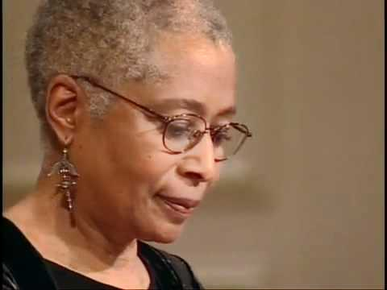
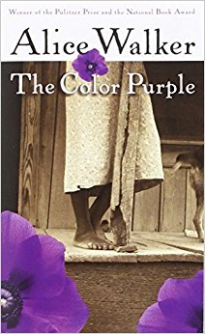
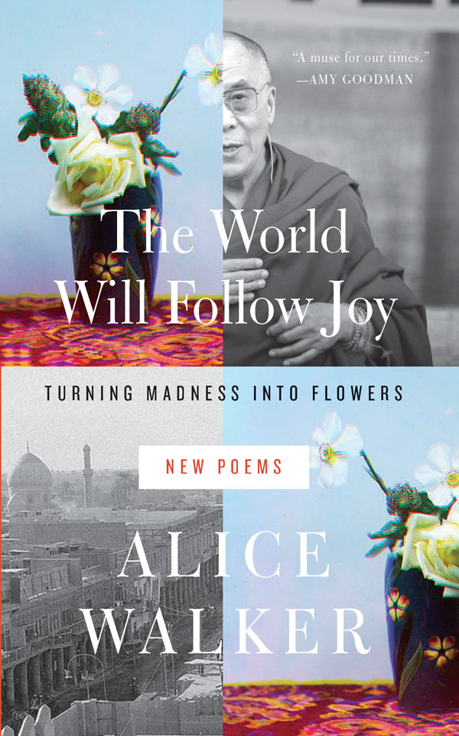
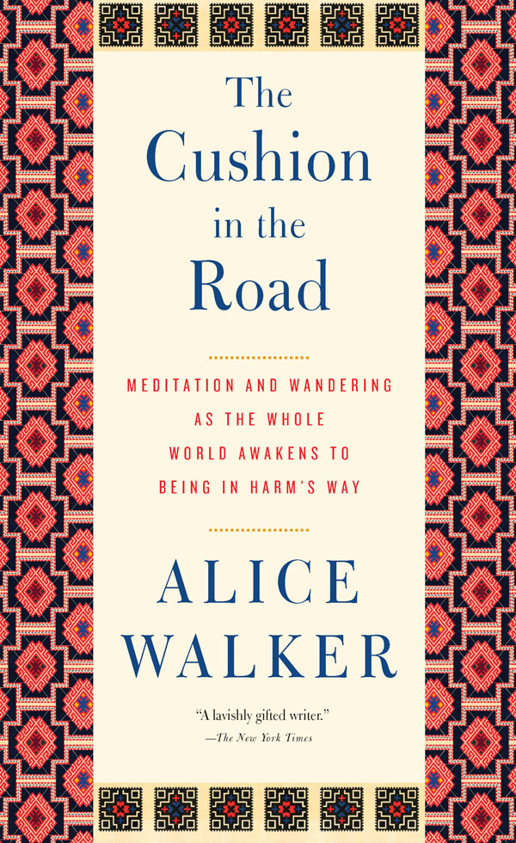
ALICE WALKER
Born in 1944- 74 years old and continues to write today
Novelist, essayist, poet, Civil Rights activist
Pulitzer Prize for The Color Purple--made into both a movie and Broadway musical
Most recent titles on right

Slide 3
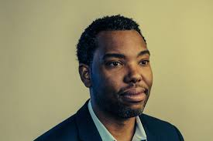
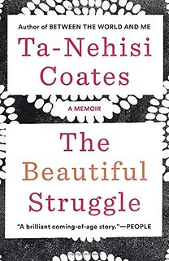
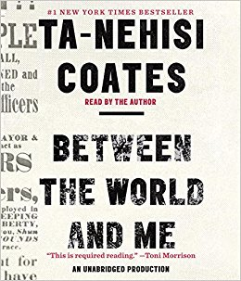
Ta-Nehisi Coates
His book Between The World And Me won the National Book Award in 2015. He is also a recipient of a MacArthur Fellowship. Since 2016, Coates has written Marvel’s The Black Panther graphic novels. He lives in New York with his wife and son.
Video of Between The World And Me

Slide 4
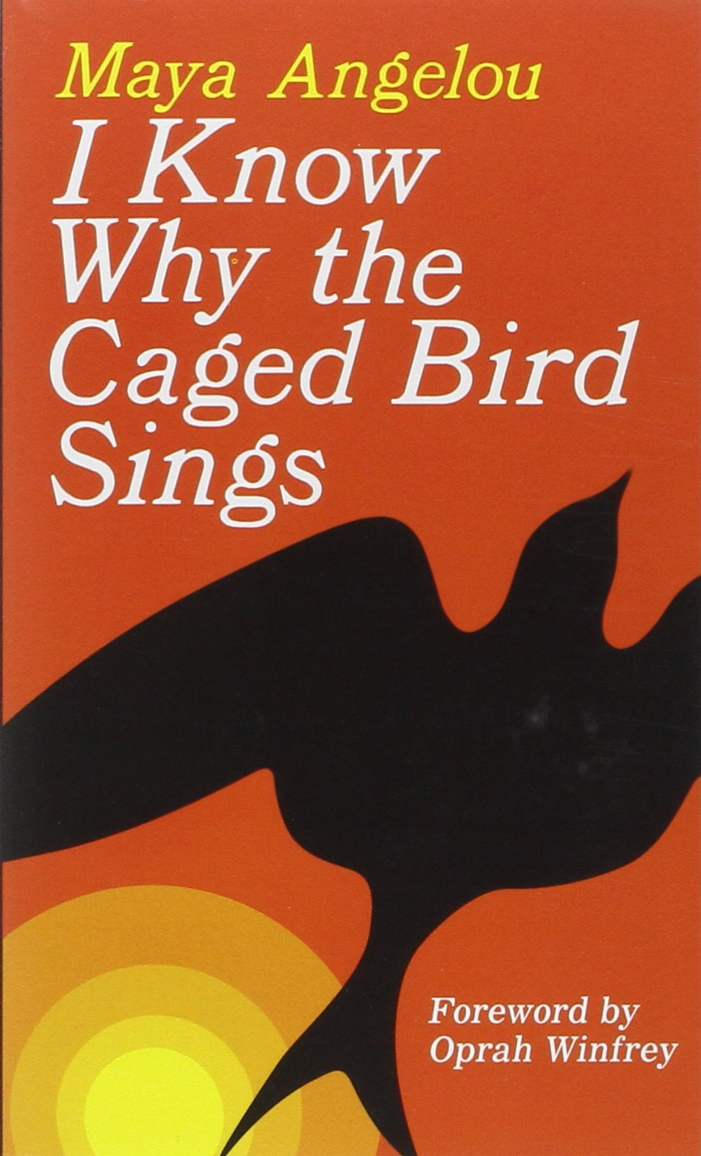
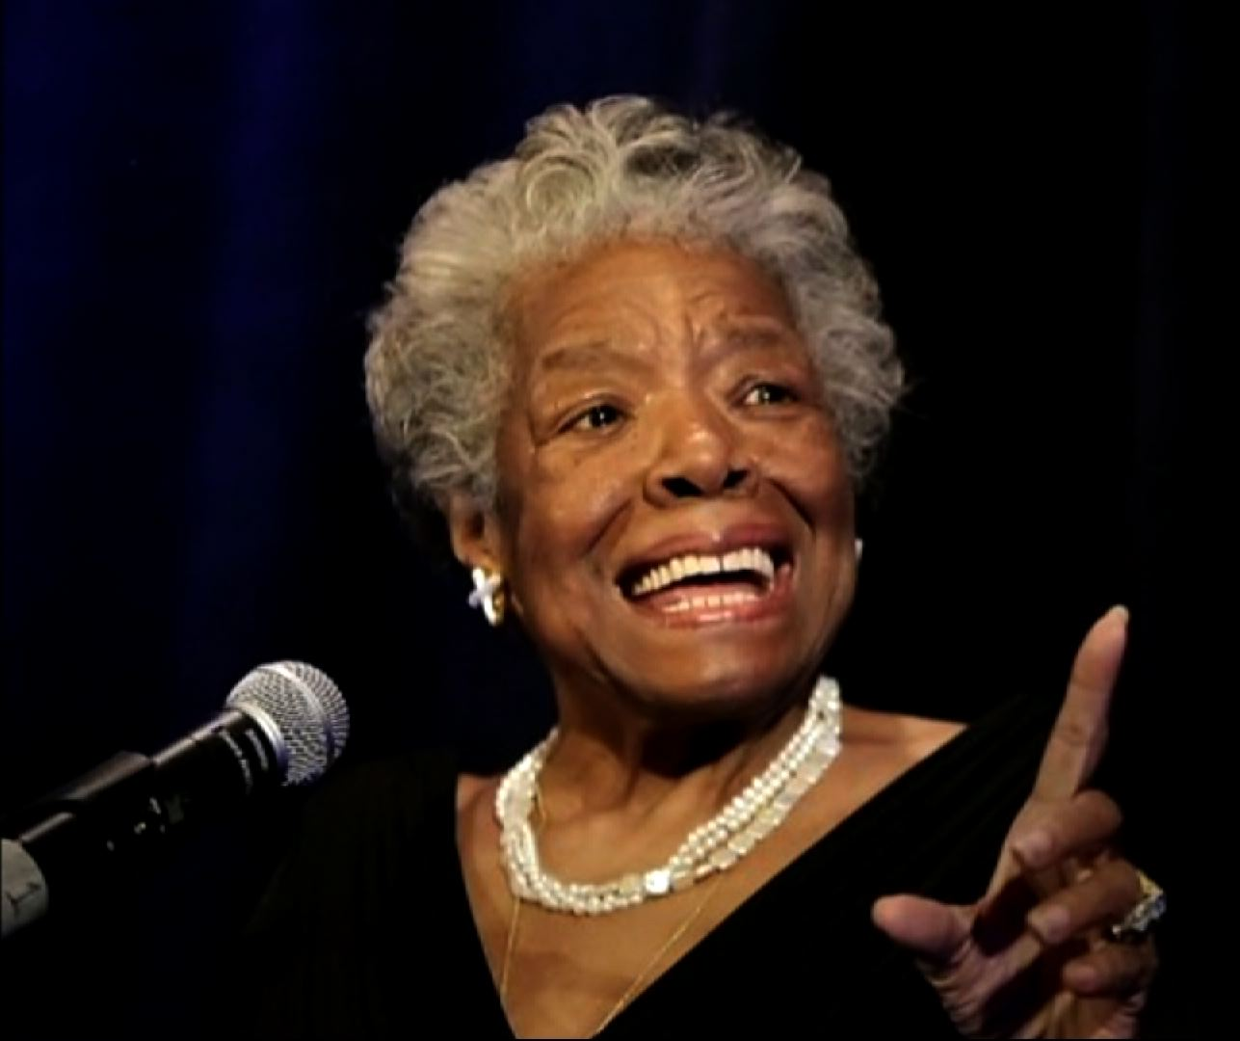
Maya Angelou
Maya Angelou interview
Born in St. Louis, Missouri, 1928-2014
Singer, dancer, actress, composer,
and Hollywood’s first female black director
Most famous as a writer, editor, essayist, playwright, and poet

Slide 5

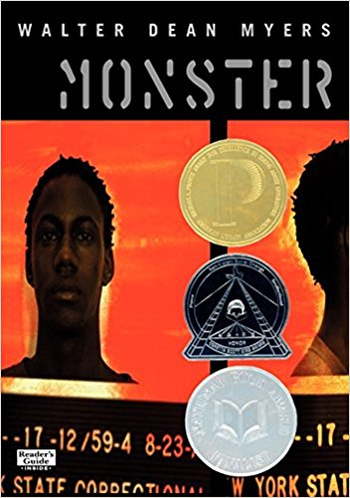
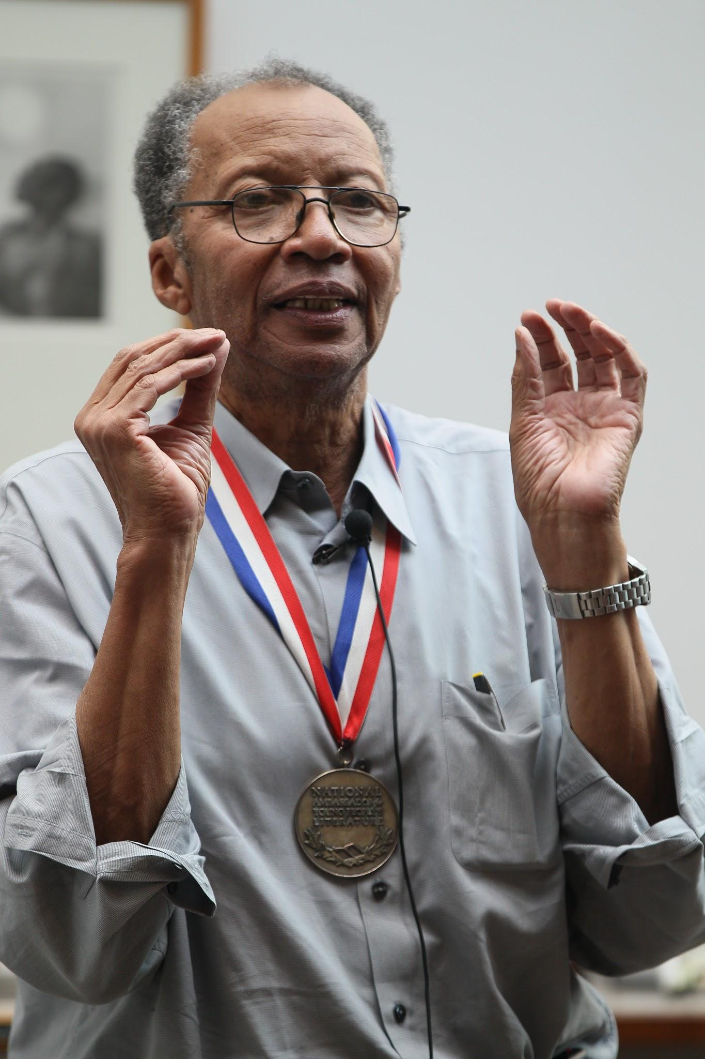
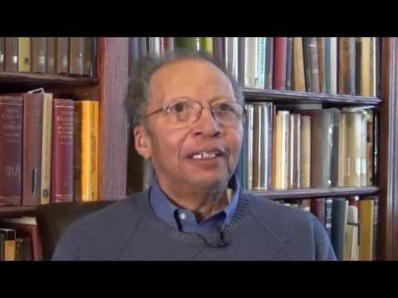
Walter Dean Myers
Born in 1937 in West Virginia, raised in Harlem, and passed away in 2014
Joined the army on his 17th birthday
Writing helped him through his struggles as he wrote about his life and experiences
Wrote over 100 books and won numerous awards
Was Library Of Congress' National Ambassador For Young People's Literature

Slide 6
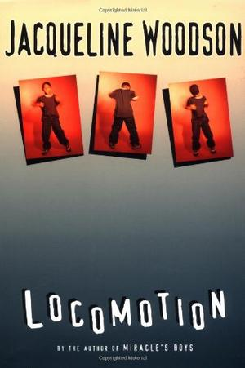
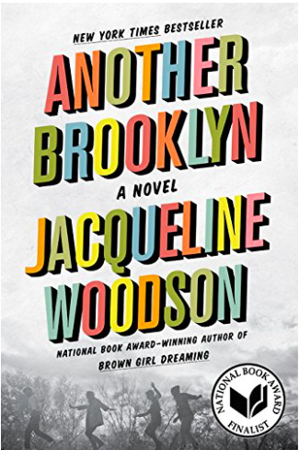
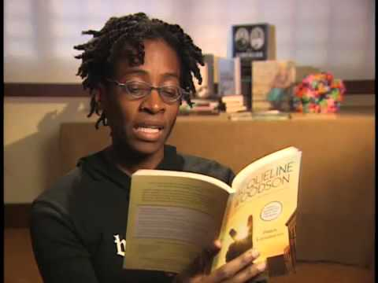
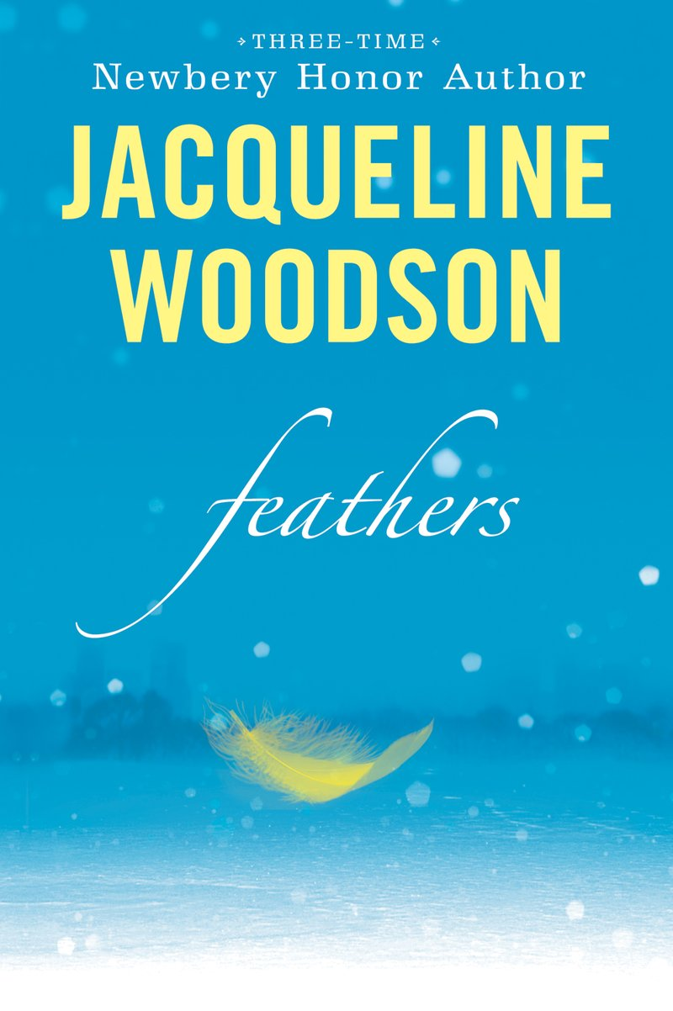
Jacqueline Woodson
Born in South Carolina
Moved to Brooklyn, NY, and has lived
there ever since
Has been writing about anything and everything since
little and believes there is no such thing as writer’s block
Named 2018 National Ambassador for Young Adult Literature

Slide 7
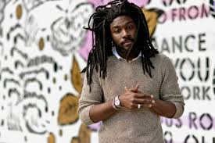
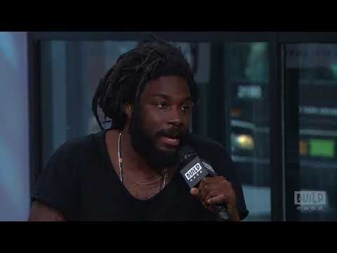
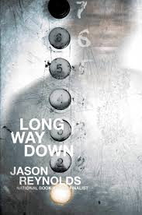
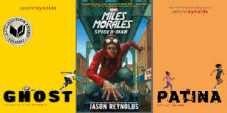
Jason Reynolds
Jason Reynolds is a young adult novelist best known for his award winning books, When I Was The Greatest and Ghost. He’s won the NAACP Image Award for Outstanding Literary Work for Youth/Teens.
Every Christmas growing up, Jason’s grandma would give him books as a gift, which lead him to have a love for poetry at only eight years old. He was first drawn to writing by Queen Latifah’s artistry in her album Black Reign.
For more info about Jason check this out.

Slide 8
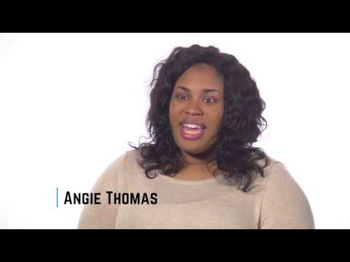
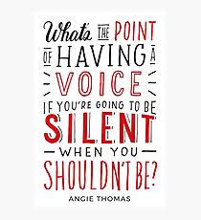
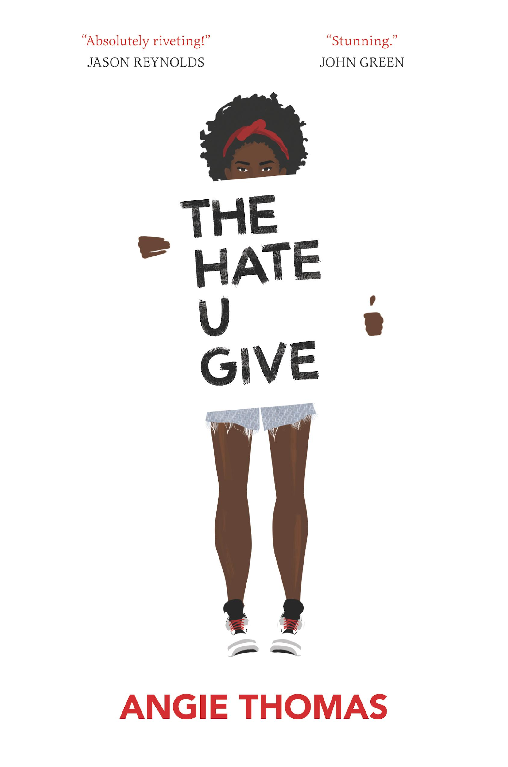
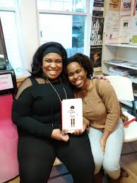
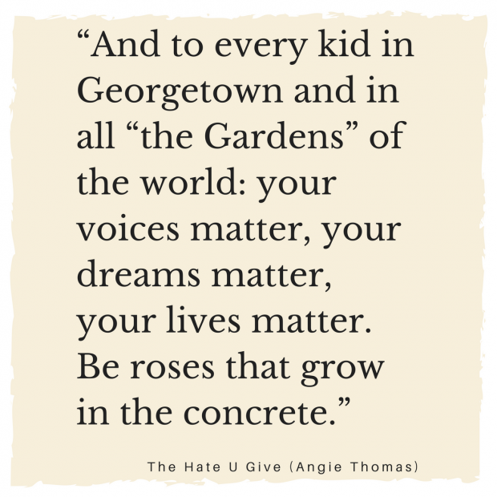
Angie Thomas
Born and raised in Jackson, Mississippi
Former teen rapper who had an article in Right-On Magazine
Has a BFA in Creative Writing from Belhaven University
Debut novel, The Hate You Give, is #1 New York Times Bestseller

Slide 9
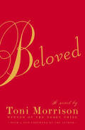
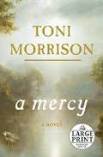
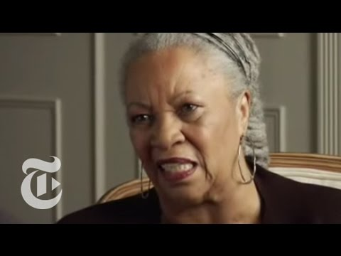
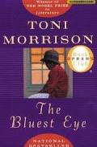
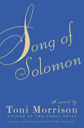
Toni Morrison
Born in Lorain, OH, and is now 86 years old
Won the Nobel Prize in Literature in 1993
Won the Pulitzer Prize for her book Beloved

Slide 10
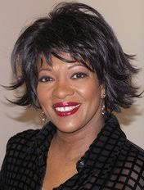
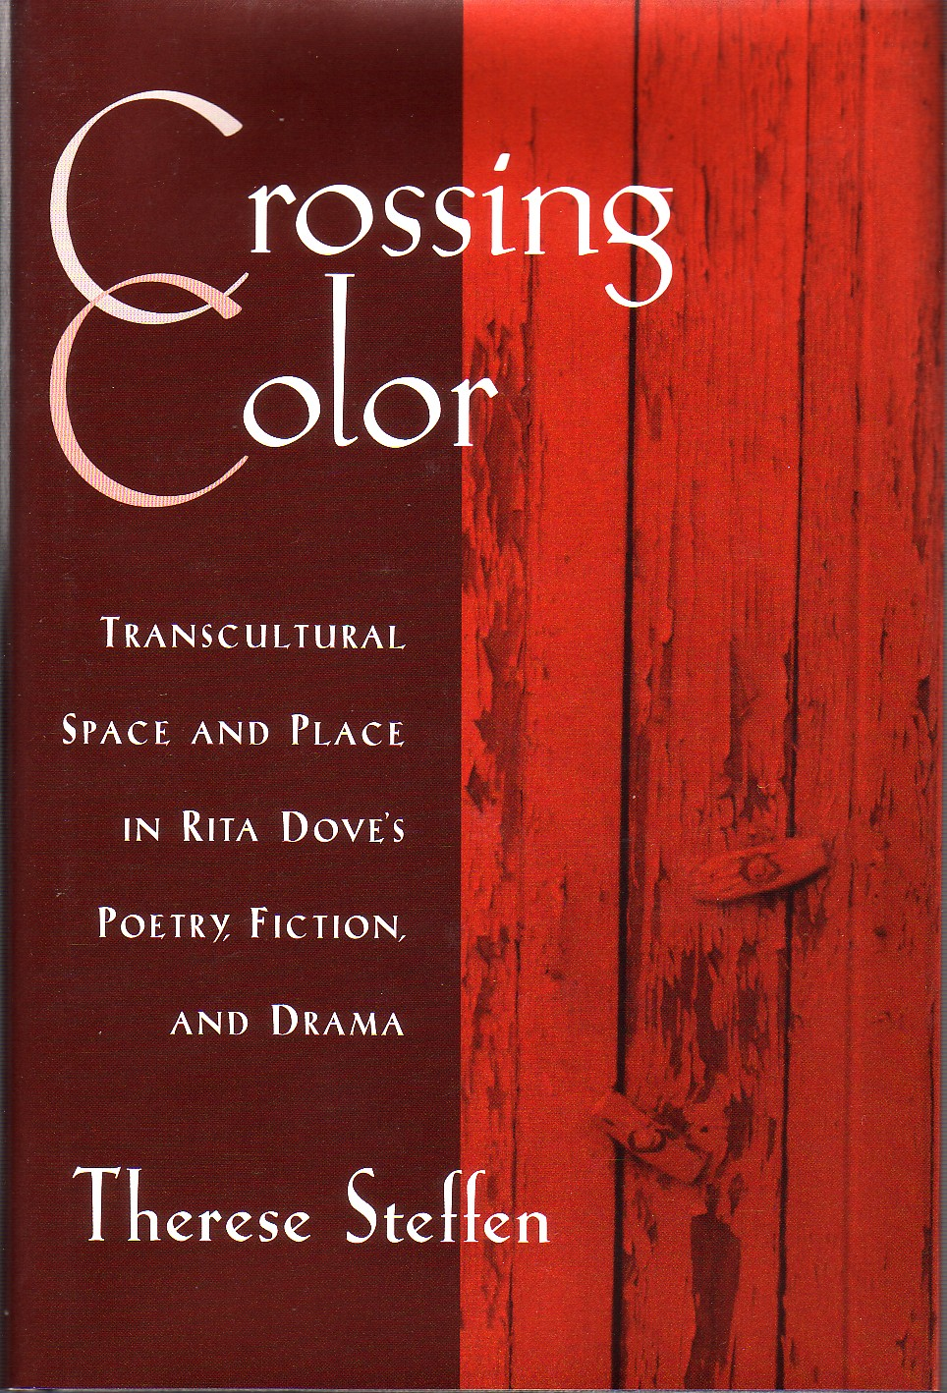
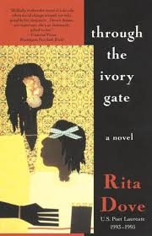
Rita Dove
Contemporary poet
Born in Akron, OH, in 1952
Served as Poet Laureate of the U.S. and Consultant to the Library of Congress (1993 to 1995)
Big Think Interview with Rita Dove
White House Poetry Evening with Rita Dove-
Heart to Heart
Recipient of the Pulitzer Prize in Poetry in 1987
Recipient of the 2011 National Medal of Arts from Barack Obama

Slide 11
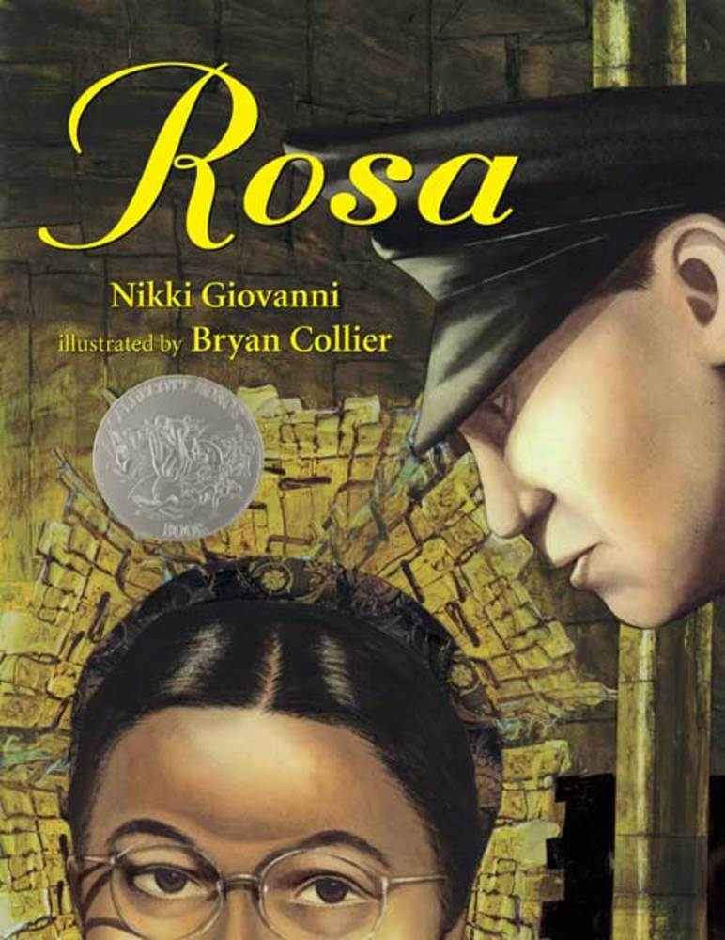
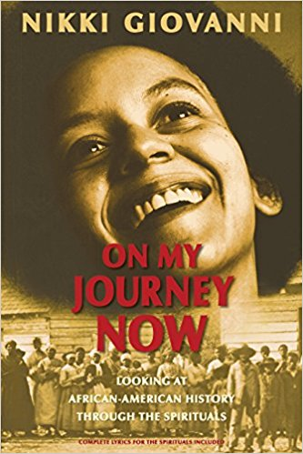
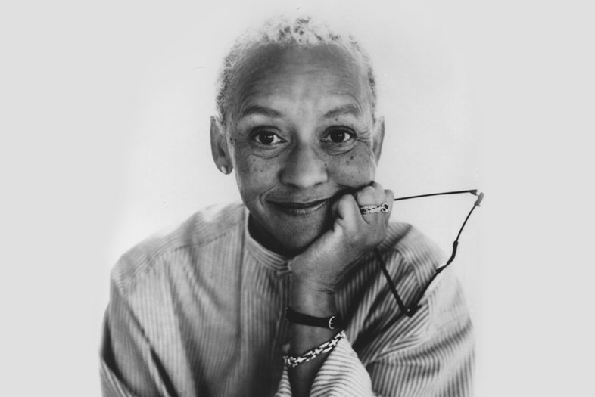
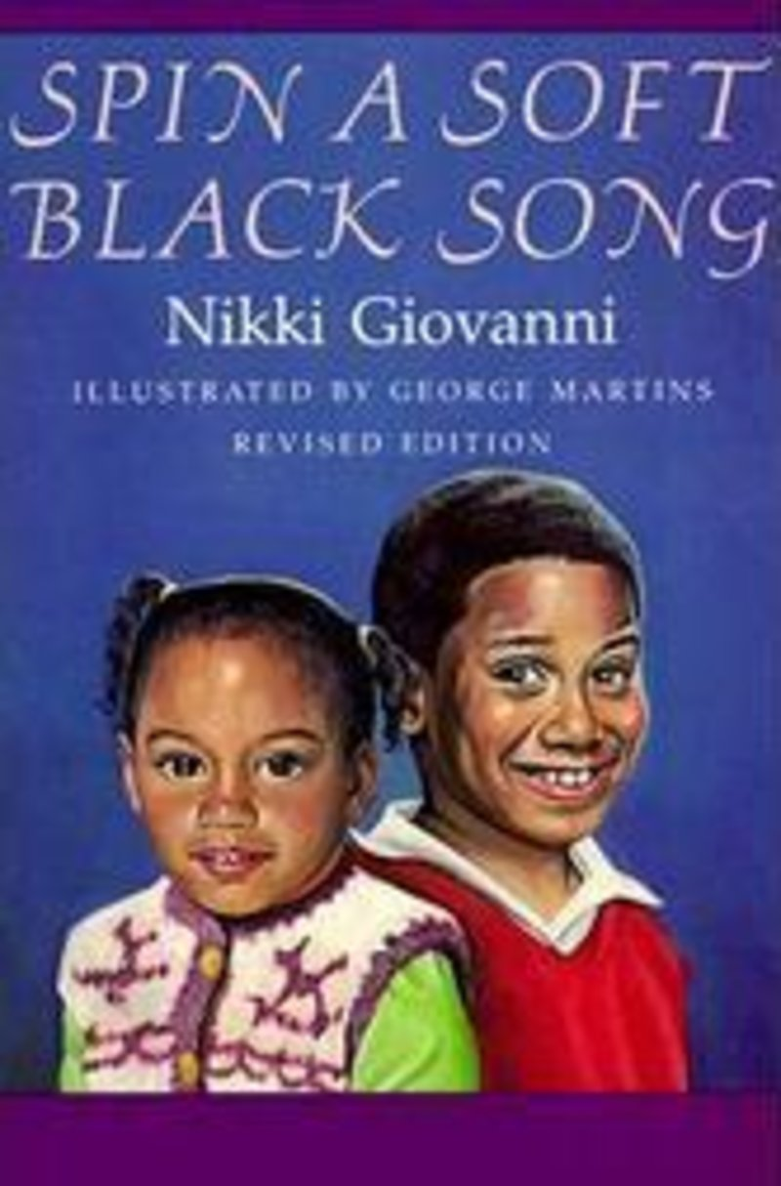
Nikki Giovanni
Poet - born in Knoxville, TN, on June 7, 1943.
Grew up in Cincinnati, OH, but returned to Knoxville each summer to visit her grandparents.
Since 1987, on the faculty at Virginia Tech, as a University Distinguished Professor.
Nikki Giovanni Gemini Reading Excerpt
awarded an unprecedented 7 NAACP Image Awards
nominated for a Grammy; been a finalist for the National Book Award
authored 3 New York Times and Los Angeles Times Best Sellers--
  highly unusual for a poet

